Slide 1
Much and many
Your online Wikwijs explanation

Slide 2
Much and many The meaning
Much → veel
Many → veel
I have much money.
I have many sets of cards.

Slide 3
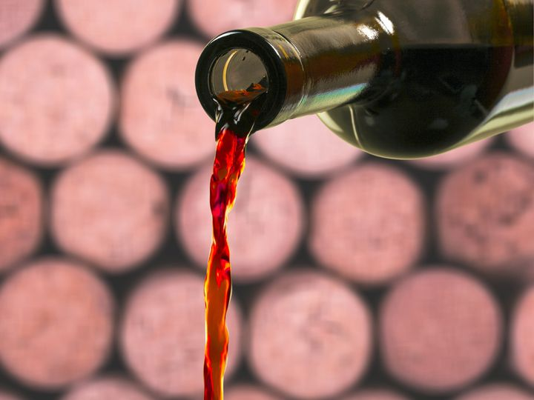
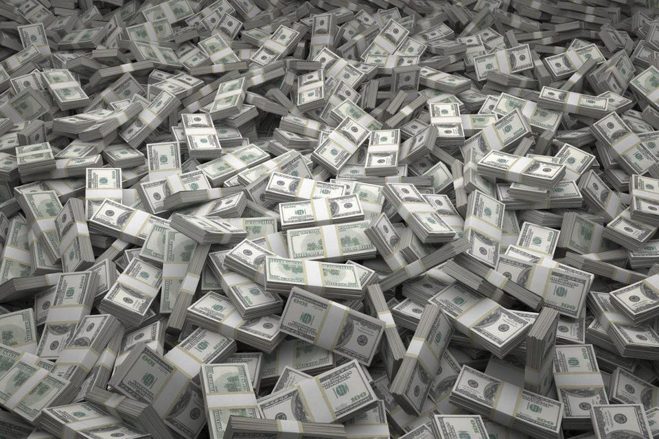
Much and many The difference
Much → uncountable noun

Slide 4
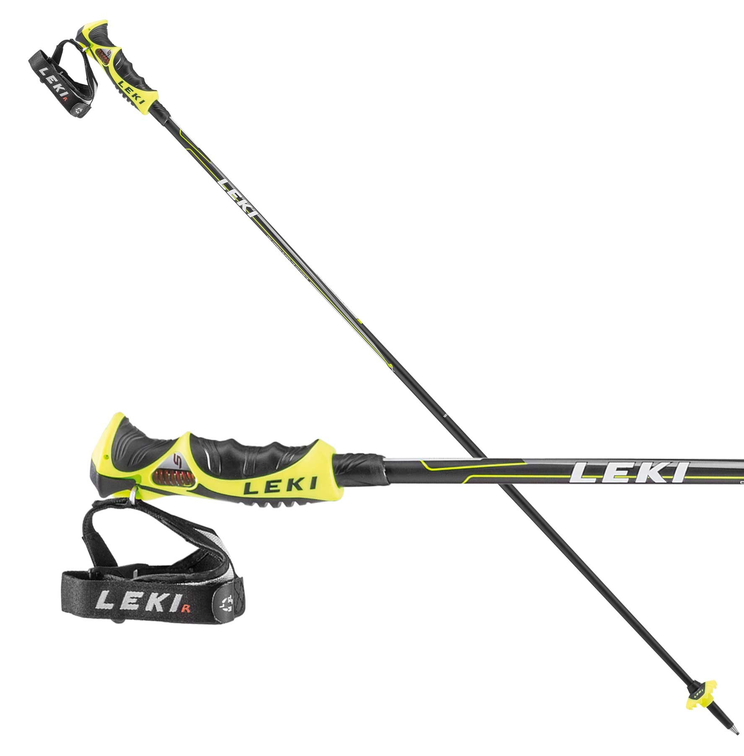
Much and many The difference
Many → countable noun

Slide 5
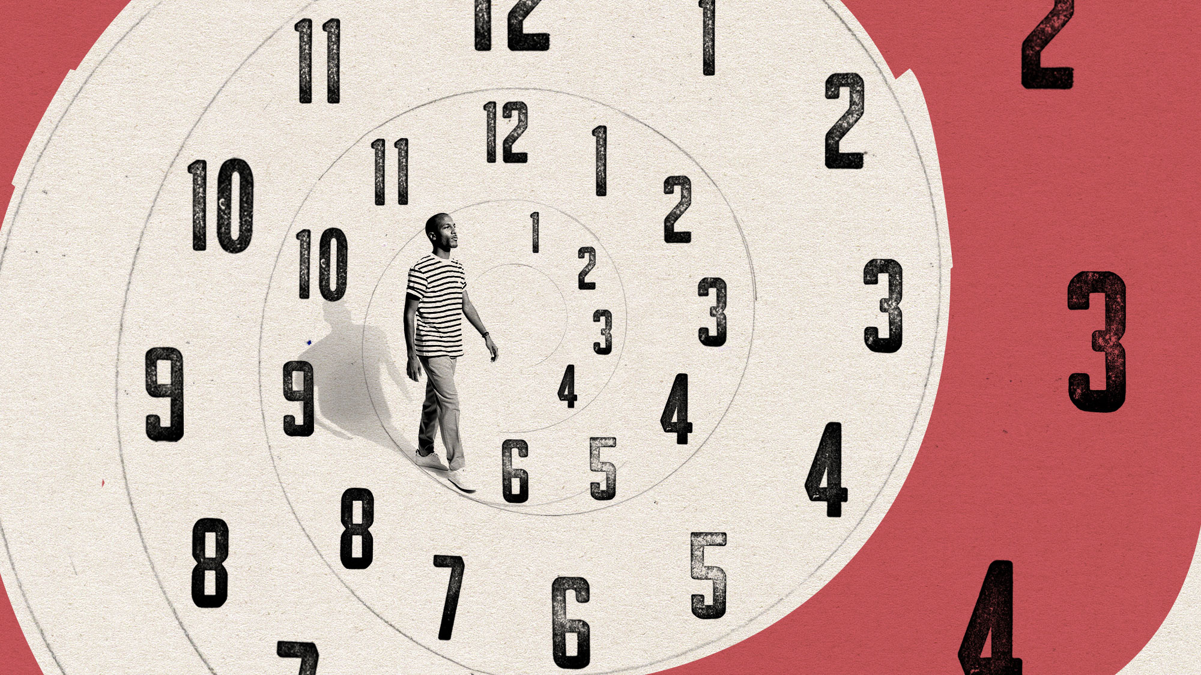
Much and many The context
Are you coming to the Christmas party?
Do you think many people will go?
Can you help me with my homework?
I don’t have much time, sorry.

Slide 6
Much and many Questions
Have you got many questions?
Send me a Teams messages/e-mail
Ask me in class

